Slide 1



Big Data Analytics

Slide 2
Big data analytics is the use of advanced analytic techniques against very large, diverse big data sets that include structured, semi-structured and unstructured data, from different sources, and in different sizes from terabytes to zettabytes

Slide 3
What is big data exactly?
Big Data is a collection of data that is huge in volume, yet growing exponentially with time. It is a data with so large size and complexity that none of traditional data management tools can store it or process it efficiently. Big data is also a data but with huge size.
Sources of data are becoming more complex than those for traditional data because they are being driven by artificial intelligence (AI), mobile devices, social media and the Internet of Things (IoT) .For example, the different types of data originate from sensors, devices, video/audio, networks, log files, transactional applications, web and social media — much of it generated in real time and at a very large scale.

Slide 4
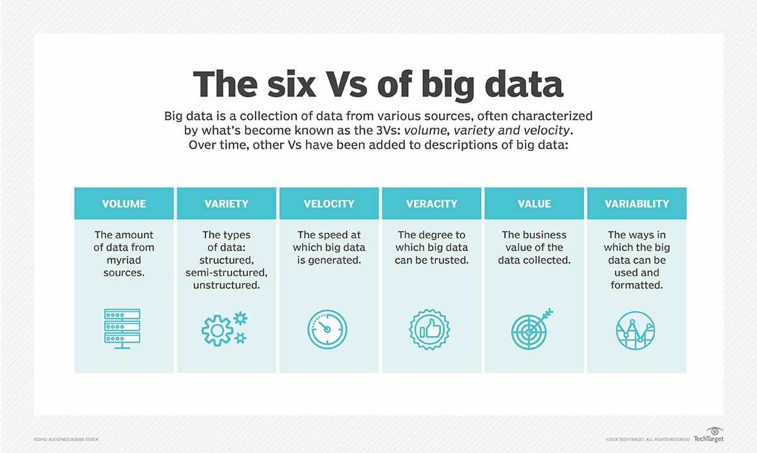
Characteristics of big data

Slide 5
Big Data Architecture: Your choice of the stack on the cloud

Slide 6
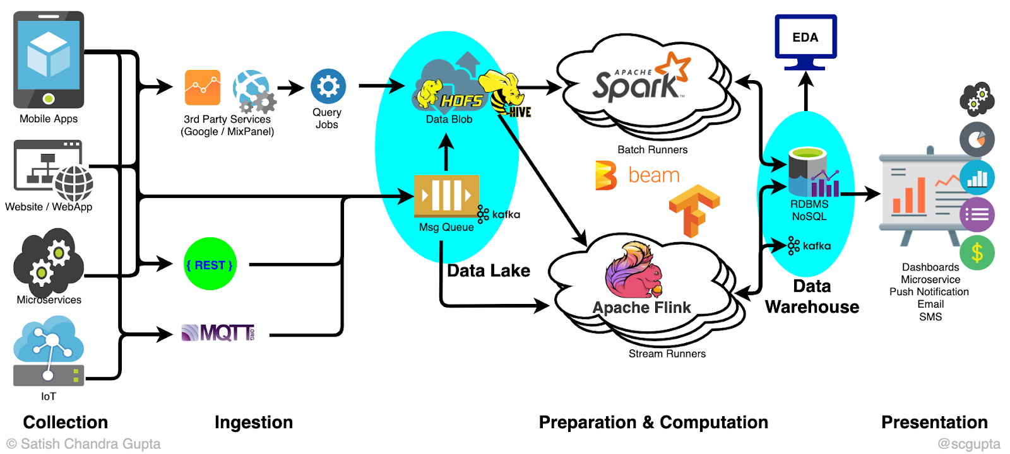
An architecture of the data pipeline using open source technologies

Slide 7
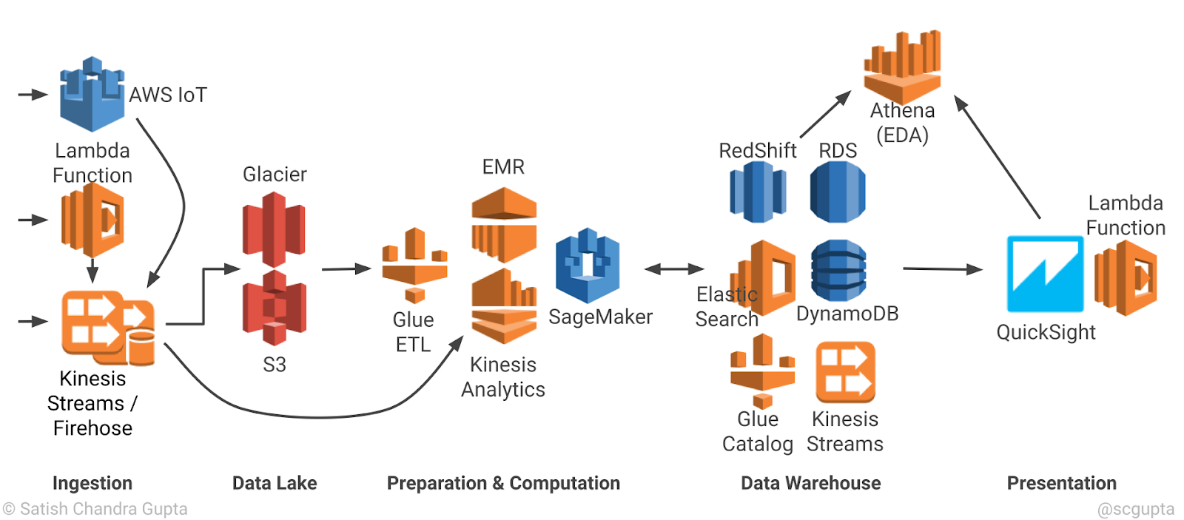
Serverless big data pipeline architecture on Amazon Web Services (AWS)

Slide 8
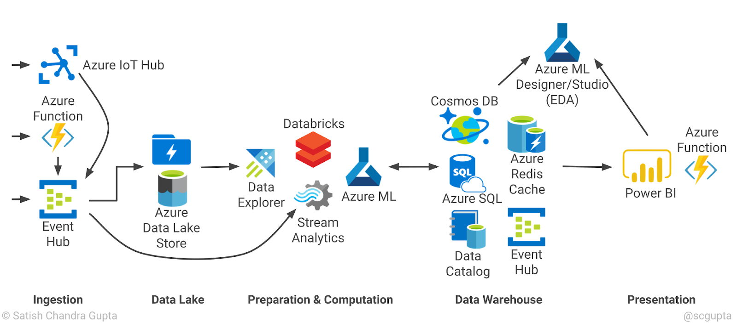
Serverless big data pipeline architecture on Microsoft Azure

Slide 9
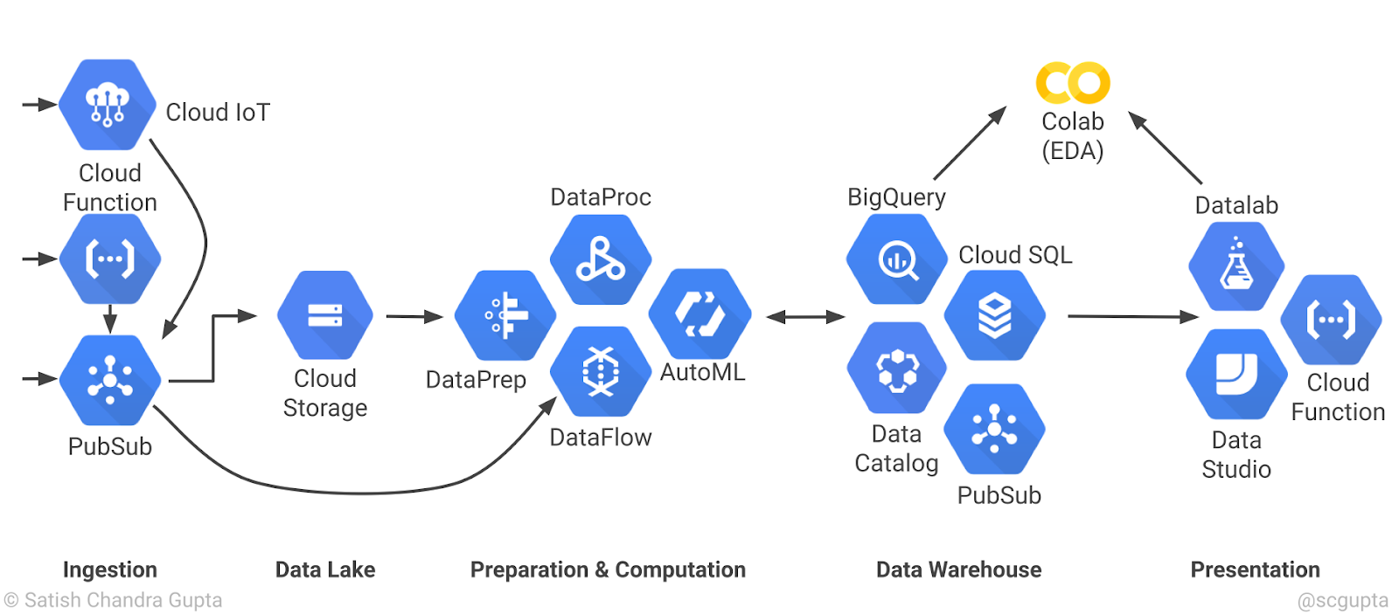
Serverless big data pipeline architecture on Google Cloud Platform (GCP)

Slide 10
large-scale data processing Library
Dask DataFrame — Flexible parallel computing library for analytics
PySpark — A unified analytics engine for large-scale data processing based on Spark.
Koalas — Pandas API on Apache Spark. https://koalas.readthedocs.io/en/latest/index.html
Vaex — A Python library for lazy Out-of-Core dataframes. https://vaex.readthedocs.io/en/latest/
Turicreate — A relatively clandestine machine learning package with its dataframe structure — SFrame, which qualifies.
Datatable — The backbone of H2O’s Driverless.ai. A dataframe package with specific emphasis on speed and big data support for a single node.
H2O — The standard in-memory dataframe is well-rounded. Still, with the recommendations of a cluster four times the size of the dataset, you need deep pockets to use it for exploration and development.
cuDF (RapidAI) — A GPU dataframe package is an exciting concept. For big data, you must use distributed GPUs with Dask to match your data size, perfect for bottomless pockets.
Modin — A tool to scale Pandas without changes to the API which uses Dask or Ray in the backend.

Slide 11
Architecture Of Giants: Data Stacks
https://keen.io/blog/architecture-of-giants-data-stacks-at-facebook-netflix-airbnb-and-pinterest/
Notes:
https://keen.io/blog/architecture-of-giants-data-stacks-at-facebook-netflix-airbnb-and-pinterest/

Slide 12
Apache Spark
Apache Spark is an open-source unified analytics engine for large-scale data processing.

Slide 13
Why Apache Spark?
Apache Spark is the most active open source data processing engine built for speed, ease of use, and advanced analytics, with over 1000 contributors from over 250 organizations and a growing community of developers and users.
Second, as a general purpose compute engine designed for distributed data processing at scale, Spark supports multiple workloads through a unified engine comprised of Spark components as libraries accessible via APIs in popular programing languages, including Scala, Java, Python, and R
it can be deployed in different environments, read data from various data sources, and interact with myriad applications.

Slide 14
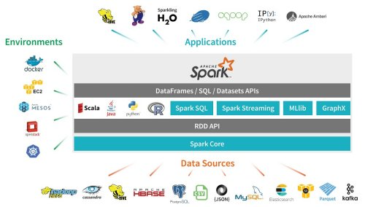
Apache Spark

Slide 15
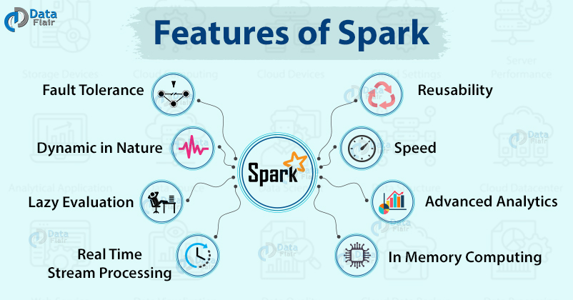
feature of Spark

Slide 16
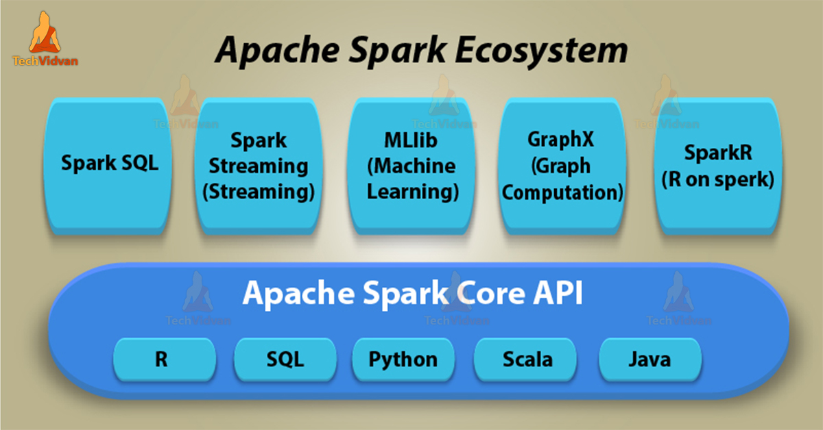
Apache Spark Ecosystem Components

Slide 17
PySpark
PySpark is an interface for Apache Spark in Python. It not only allows you to write Spark applications using Python APIs, but also provides the PySpark shell for interactively analyzing your data in a distributed environment.
PySpark is a great language for data scientists to learn because it enables scalable analysis and ML pipelines. If you're already familiar with Python and Pandas, then much of your knowledge can be applied to Spark.

Slide 18
Environment
There’s a number of different options for getting up and running with Spark:
Self Hosted: You can set up a cluster yourself using bare metal machines or virtual machines. Apache Ambari is a useful project for this option, but it’s not my recommended approach for getting up and running quickly.
Cloud Providers: Most cloud providers offer Spark clusters: AWS has EMR and GCP has DataProc. I’ve blogged about DataProc in the past, and you can get to an interactive environment quicker than self-hosting
.Vendor Solutions: Companies including Databricks and Cloudera provide Spark solutions, making it easy to get up and running with Spark.

Slide 19
Practical
Databricks or Google Colab

